Slide 1
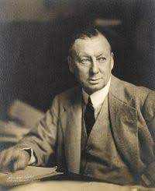
The Town Week By E. V. Lucas
goodreads.com (google images)
Edward Verrall Lucas (1868-1938) was -
- an English essayist, novelist, poet, journalist, biographer, autobiographer, short story writer, playright, and satirist.
- associated with the humorous magazine Punch for long.
- He is well known as the editor of Charles Lambs Works.
-He achieved success as a prolific author of light, entertaining popular nonfiction and novels.
- He is best known as a witty and observant essayist.

Slide 2
E. V. Lucas has given a vivid picture of the moods and sentiments of the urban people on different days of the week.
Monday
Thursday
Saturday
Tuesday
Friday
Sunday
Wednesday

Slide 3
Mondayish is the only word which the days of the week have given us.
Mondayish :
Mondayish (Adverb)
on, or around Monday
I hope to have the job finished by Mondayish.
Mondayish(Adjective)
feeling ill, especially used re clergymen after working all day Sunday
Mondayish(Adjective)
hungover after a weekend of drinking (as a presumed contributing explanation for a clergyman feeling Mondayish)
Mondayish(Adjective)
grumpy and disheartened on returning to work on a Monday after the weekend
I feel a bit Mondayish this week at the start of a long project.
(https://www.definitions.net/definition/mondayish)
Tuesdayish X
Wednesdayish X
Thursdayish X
Fridayish X
Saturdayish X
Sundayish X

Slide 4
Monday Tuesday
-possesses positive character.
-it is indicated by cardinal number 1 as it is beginning of the week.
- E. V. Lucas pints out - i) it brings a feeling of revolt among men. Therefore the American revivalist held no meetings on Monday.
On the other hand-
Monday is flat as one has been idling because so many days have to pass to reach the weekend. .
-
Tuesday is flat, dull and a tame follower of the courageous beginner.
We get reconciled to the work.
As on Tuesday people don’t prefer to dine out, the chef don’t try different dishes on Tuesday.
E. V. Lucas humorously says Tuesday is difficult to spell as well.

Slide 5
Wednesday
Wednesday is bland. (mild, soft, gentle).
With Wednesday the week stirs itself.
There are matinees on Wednesday.
Things of adventure may happen on Wednesday.
On Wednesday one’s friends are pretty sure to be accessible.
As people are very active, politicians realised that they should not continue their acrimonious business for more than an hour.
Very humourously E. V. Lucas points out the reason of the failure of the previous government is that their atheistical decision not to consider Wednesday as holy day.

Slide 6
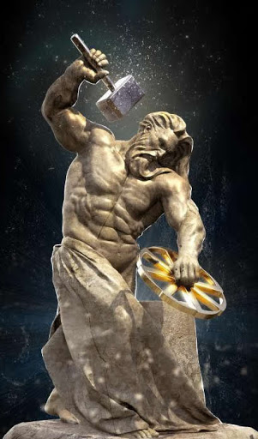
Thursday
google images
On Thursday people forget the stirring of Wednesday.
-They return to folding of hands.
- It is good honest day.
- As people are not active on this day, it cannot be called Thor’s day ( black smith-god).
The writer comments:
If I were a businessman, I should, I am certain, sell my shares at a loss on Monday(Dull Day), a profit on Wednesday ( Active Day) and Friday, but on Tuesday and Thursday I should get for them exactly what I gave.

Slide 7
I grouped Friday with Wednesday.
Wednesday is calm, assured, urbane, Friday allows to be a little flurried and excited.
Wednesday stands alone, Friday to some extent throws in its lot with Saturday.
Friday is too busy. Too many papers come out, too many bags are packed.
Friday is beginning of the end, forerunner of Saturday and Sunday.
Friday is perhaps the best day of the week, for one spends much of it in thinking of the tomorrow and what of good it should bring forth.
Friday’s greatest merit is that it paves way to Saturday and the cessation of work.

Slide 8
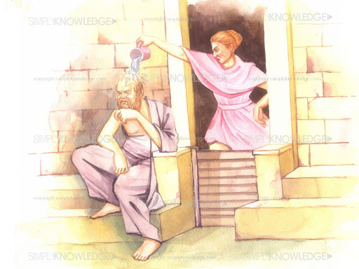
Saturday And Sunday
Saturday and Sunday pass from the region of definable days.
All other days have a fixed character more or less.
Saturday and Sunday are what we individually make of them.
In one family they are friends and associates and in another,
as ill assorted as Socrates and Xantippe. (Husband And Wife).
Saturday is not a day at all, it is a collection of hours, part work,
part pleasure and all restlessness.
On Saturday trains are full and shops shutt too early.

Slide 9
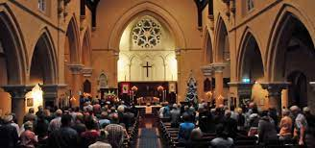
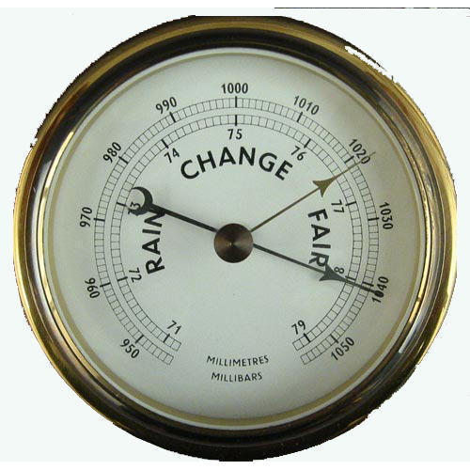
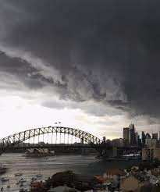
Sunday
Sunday is different to different people.
For godly men and children it is holy.
For the ungodly men, it is a day jeopardised
by an interest in barometers. (google images)
(A device that measures air pressure,
and shows when the weather is likely
to change).
To one it is an interruption of
the week, to another it is the week itself, and all the rest
of the days are but preparations for it.

