Slide 1
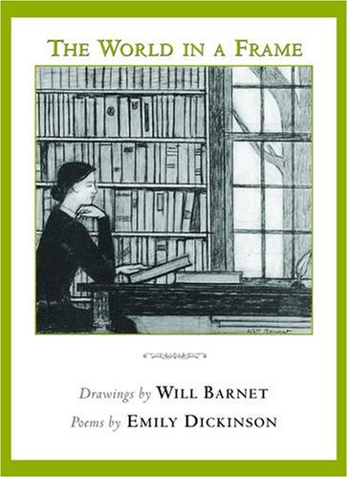
Success is Counted Sweetest
By Emily Dickinson
Emily Dickinson was the daughter of a conservative New England Lawyer born in Amherest, Massachusetts. (US)
-Throughout her life she remained single and confined herself within the walls of her house.
-
-She started composing poems in her twenties and wrote more than 1700 short poems.
-
-She excelled in her writing short, dedicated lyrics, rich in feeling and imagination.
-
-Simple diction and unconventional imagery are the speciality of her poetry.

Slide 2

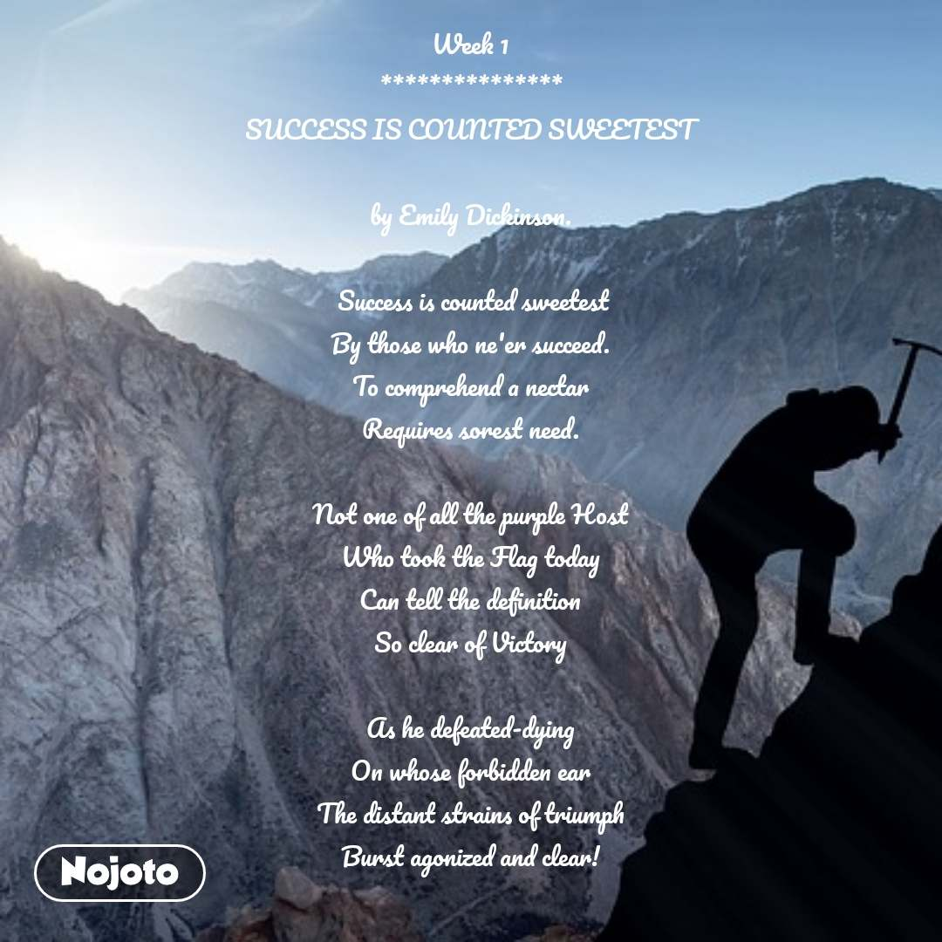
Success is counted sweetest
By those who ne'er succeed.
To comprehend a nectar
Requires sorest need.

Slide 3
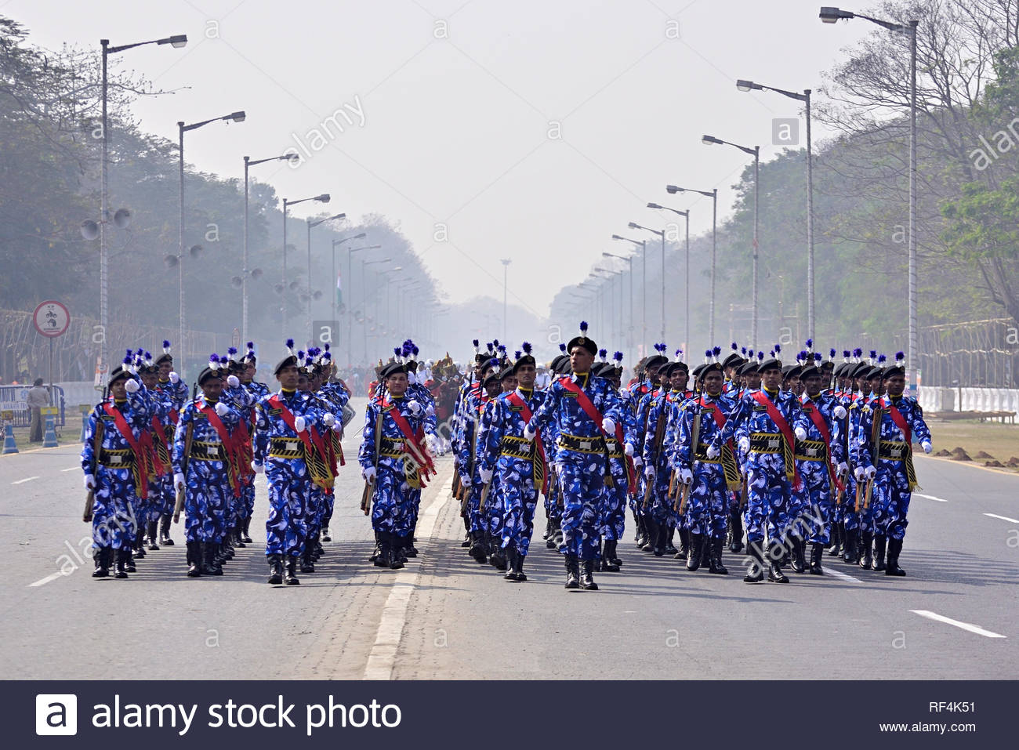
Not one of all the purple Host
Who took the Flag today
Can tell the definition
So clear of victory

Slide 4
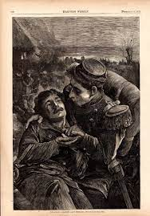
As he defeated – dying –
On whose forbidden ear
The distant strains of triumph
Burst agonized and clear!

