Slide 1
UV / Visible Spectroscopy
Mr. Santosh L. Kumbhare
Assistant Professor
Shri Shivaji Science & Arts college, Chikhli
Dist. - Buldana
Notes:
This template can be used as a starter file for presenting training materials in a group setting.
Sections
Right-click on a slide to add sections. Sections can help to organize your slides or facilitate collaboration between multiple authors.
Notes
Use the Notes section for delivery notes or to provide additional details for the audience. View these notes in Presentation View during your presentation.
Keep in mind the font size (important for accessibility, visibility, videotaping, and online production)
Coordinated colors
Pay particular attention to the graphs, charts, and text boxes.
Consider that attendees will print in black and white or grayscale. Run a test print to make sure your colors work when printed in pure black and white and grayscale.
Graphics, tables, and graphs
Keep it simple: If possible, use consistent, non-distracting styles and colors.
Label all graphs and tables.

Slide 2
Spectroscopy
It is the branch of science that deals with the study of interaction of matter with light.
OR
It is the branch of science that deals with the study of interaction of electromagnetic radiation with matter.
Notes:
Give a brief overview of the presentation. Describe the major focus of the presentation and why it is important.
Introduce each of the major topics.
To provide a road map for the audience, you can repeat this Overview slide throughout the presentation, highlighting the particular topic you will discuss next.

Slide 3

Electromagnetic Radiation
Notes:
This is another option for an Overview slides using transitions.

Slide 4
Electromagnetic radiation is the energy transmitted through the space in the form of waves
Electromagnetic radiation consist of discrete packages of energy which are called as photons.
Electromagnetic radiation consists of an oscillating electric field (E) & an oscillating magnetic field (M) which are perpendicular to each other.
Notes:
What will the audience be able to do after this training is complete? Briefly describe each objective how the audience will benefit from this presentation.

Slide 5
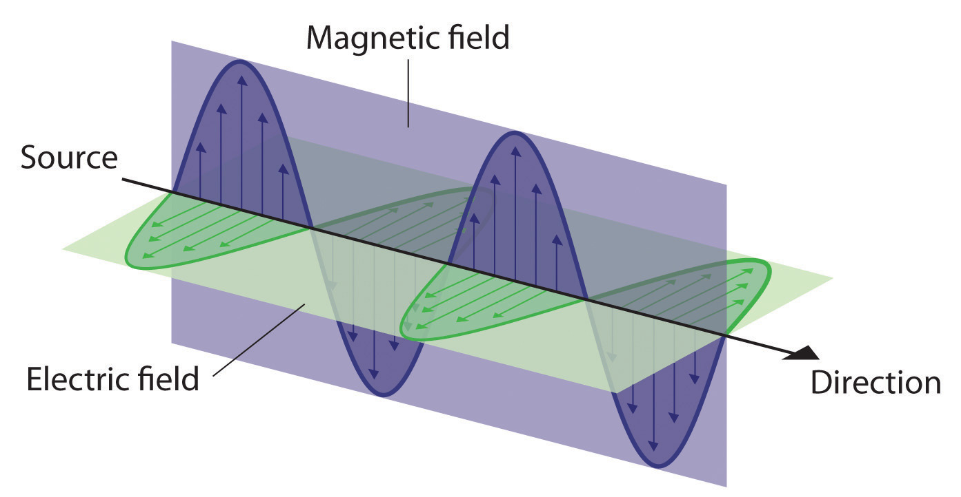
Notes:
This is another option for an Overview slides using transitions.

Slide 6
Electromagnetic Radiation
Frequency (ν):
  It is defined as the number of times electrical field radiation oscillates in one second.
  The unit for frequency is Hertz (Hz).
  1 Hz = 1 cycle per second
Wavelength (λ):
  It is the distance between two nearest parts of the wave in the same phase i.e. distance between two nearest crest or troughs.
Notes:
What will the audience be able to do after this training is complete? Briefly describe each objective how the audience will benefit from this presentation.

Slide 7

Electromagnetic Radiation
The relationship between wavelength & frequency can be written as:
c = ν λ
As photon is subjected to energy, so
E = h ν = h c / λ
Notes:
What will the audience be able to do after this training is complete? Briefly describe each objective how the audience will benefit from this presentation.

Slide 8
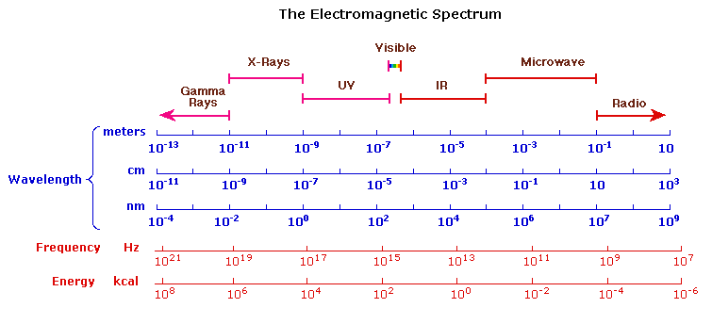
Electromagnetic Radiation
Electromagnetic radiations arrange according to decreasing frequency and increasing wavelength gives electromagnetic spectrum
Notes:
What will the audience be able to do after this training is complete? Briefly describe each objective how the audience will benefit from this presentation.

Slide 9
UV radiation region extends from 10nm to 400nm
Visible region extends from 400nm to 800nm
Notes:
This is another option for an Overview slides using transitions.

Slide 10
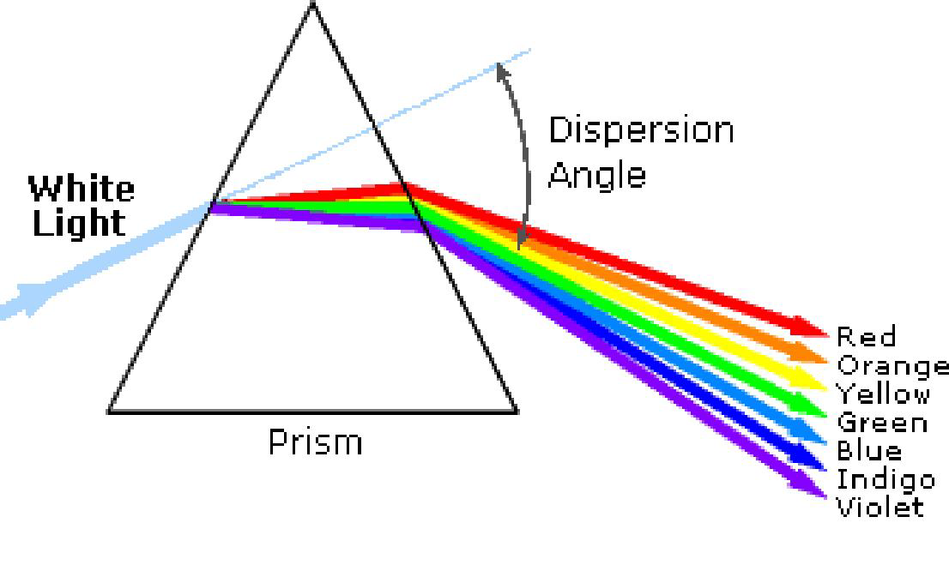
Visible Radiation
Violet | 400 - 420 nm | Yellow | 570 - 585 nm
Indigo | 420 - 440 nm | Orange | 585 - 620 nm
Blue | 440 - 490 nm | Red | 620 - 780 nm
Green | 490 - 570 nm
Notes:
What will the audience be able to do after this training is complete? Briefly describe each objective how the audience will benefit from this presentation.

Slide 11

Interaction of EMR with Matter

Slide 12
Interaction of UV Visible Radiation with matter
Electronic Energy Levels:
At room temperature the molecules are in the lowest energy levels E₀.
When the molecules absorb UV-visible light from EMR, one of the outermost bond / lone pair electron is promoted to higher energy state such as E₁, E₂, …E_{n}, etc is called as electronic transition and the difference is as:
∆E = h ν = E_{n} - E₀ where (n = 1, 2, 3, … etc)
∆E = 35 to 71 kcal/mole
Notes:
What will the audience be able to do after this training is complete? Briefly describe each objective how the audience will benefit from this presentation.

Slide 13
Lambert’s
Law

Slide 14
Lambert’s Law
When a monochromatic radiation is passed through a solution, the decrease in the intensity of radiation with thickness of the solution is directly proportional to the intensity of the incident light.
Let I be the intensity of incident radiation.
  x be the thickness of the solution.
  Then
Notes:
Give a brief overview of the presentation. Describe the major focus of the presentation and why it is important.
Introduce each of the major topics.
To provide a road map for the audience, you can repeat this Overview slide throughout the presentation, highlighting the particular topic you will discuss next.

Slide 15
Lambert’s Law
So,
Integrate equation between limit
I = Io at x = 0 and
I = I at x=l,
We get,
Notes:
Give a brief overview of the presentation. Describe the major focus of the presentation and why it is important.
Introduce each of the major topics.
To provide a road map for the audience, you can repeat this Overview slide throughout the presentation, highlighting the particular topic you will discuss next.

Slide 16
Lambert’s Law
Where, Absorbance
Absorption coefficient
Lambert’s Law
Notes:
Give a brief overview of the presentation. Describe the major focus of the presentation and why it is important.
Introduce each of the major topics.
To provide a road map for the audience, you can repeat this Overview slide throughout the presentation, highlighting the particular topic you will discuss next.

Slide 17
Beer’s
Law

Slide 18
Beer’s Law
When a monochromatic radiation is passed through a solution, the decrease in the intensity of radiation with thickness of the solution is directly proportional to the intensity of the incident light as well as concentration of the solution.
Let I be the intensity of incident radiation.
  x be the thickness of the solution.
  C be the concentration of the solution.
  Then
Notes:
Give a brief overview of the presentation. Describe the major focus of the presentation and why it is important.
Introduce each of the major topics.
To provide a road map for the audience, you can repeat this Overview slide throughout the presentation, highlighting the particular topic you will discuss next.

Slide 19
Beer’s Law
So,
Integrate equation between limit
I = Io at x = 0 and
I = I at x=l,
We get,
Notes:
Give a brief overview of the presentation. Describe the major focus of the presentation and why it is important.
Introduce each of the major topics.
To provide a road map for the audience, you can repeat this Overview slide throughout the presentation, highlighting the particular topic you will discuss next.

Slide 20
Beer’s Law
Where, Absorbance
Molar extinction coefficient
Beer’s Law
Notes:
Give a brief overview of the presentation. Describe the major focus of the presentation and why it is important.
Introduce each of the major topics.
To provide a road map for the audience, you can repeat this Overview slide throughout the presentation, highlighting the particular topic you will discuss next.

Slide 21
Beer’s Law
OR
  From the equation it is seen that the absorbance which is also called as optical density (OD) of a solution in a container of fixed path length is directly proportional to the concentration of a solution.
Notes:
Give a brief overview of the presentation. Describe the major focus of the presentation and why it is important.
Introduce each of the major topics.
To provide a road map for the audience, you can repeat this Overview slide throughout the presentation, highlighting the particular topic you will discuss next.

Slide 22
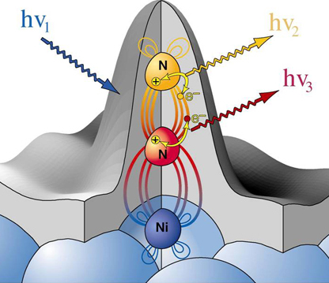
Electronic Transitions

Slide 23
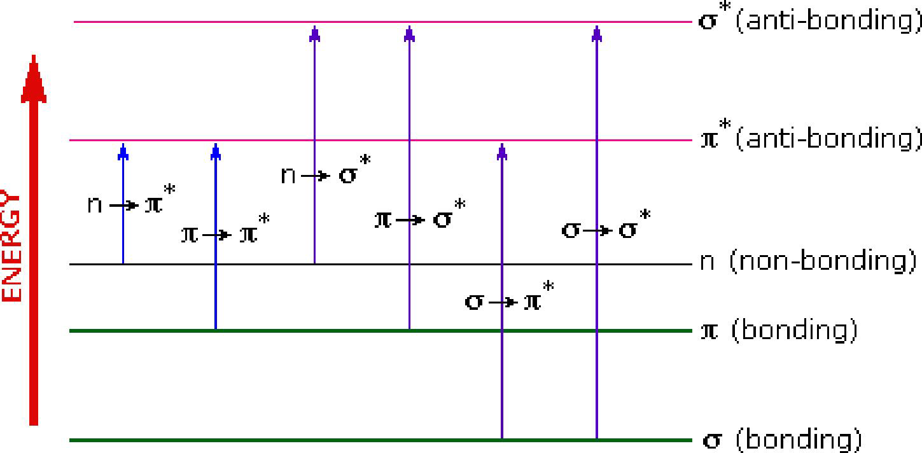
The possible electronic transitions can graphically shown as:
Notes:
This is another option for an Overview slide.

Slide 24
The possible electronic transitions are
1
2
π → π* transition
3
n → σ* transition
σ → σ* transition
4
n → π* transition
5
σ → π* transition
6
π → σ* transition
Notes:
This is another option for an Overview slide.

Slide 25
1
  σ → σ* transition
σ electron from orbital is excited to corresponding anti-bonding orbital σ*.
The energy required is large for this transition.
e.g. Methane (CH₄) has C-H bond only and can undergo σ → σ* transition and shows absorbance maxima at 125 nm.
Notes:
This is another option for an Overview slide.

Slide 26
2
  π → π* transition
π electron in a bonding orbital is excited to corresponding anti-bonding orbital π*.
Compounds containing multiple bonds like alkenes, alkynes, carbonyl, nitriles, aromatic compounds, etc undergo π → π* transitions.
e.g. Alkenes generally absorb in the region 170 to 205 nm.
Notes:
This is another option for an Overview slide.

Slide 27
3
  n → σ* transition
Saturated compounds containing atoms with lone pair of electrons like O, N, S and halogens are capable of n → σ* transition.
These transitions usually requires less energy than σ → σ* transitions.
The number of organic functional groups with n → σ* peaks in UV region is small (150 – 250 nm).
Notes:
This is another option for an Overview slide.

Slide 28
4
  n → π* transition
An electron from non-bonding orbital is promoted to anti-bonding π* orbital.
Compounds containing double bond involving hetero atoms (C=O, C≡N, N=O) undergo such transitions.
n → π* transitions require minimum energy and show absorption at longer wavelength around 300 nm.
Notes:
This is another option for an Overview slide.

Slide 29
5
  σ → π* transition
&
  π → σ* transition
6
These electronic transitions are forbidden transitions & are only theoretically possible.
Thus, n → π* & π → π* electronic transitions show absorption in region above 200 nm which is accessible to UV-visible spectrophotometer.
The UV spectrum is of only a few broad of absorption.
Notes:
This is another option for an Overview slide.

Slide 30

Terms used in
UV / Visible Spectroscopy

Slide 31
Chromophore
The part of a molecule responsible for imparting color, are called as chromospheres.
OR
The functional groups containing multiple bonds capable of absorbing radiations above 200 nm due to n → π* & π → π* transitions.
e.g. NO₂, N=O, C=O, C=N, C≡N, C=C, C=S, etc
Notes:
Add slides to each topic section as necessary, including slides with tables, graphs, and images.
See next section for sample table, graph, image, and video layouts.

Slide 32
Chromophore
To interpretate UV – visible spectrum following points should be noted:
Non-conjugated alkenes show an intense absorption below 200 nm & are therefore inaccessible to UV spectrophotometer.
Non-conjugated carbonyl group compound give a weak absorption band in the 200 - 300 nm region.
Notes:
Add slides to each topic section as necessary, including slides with tables, graphs, and images.
See next section for sample table, graph, image, and video layouts.

Slide 33
Chromophore
e.g. Acetone which has λ_{max} = 279 nm
and that cyclohexane has λ_{max} = 291 nm.
When double bonds are conjugated in a compound λ_{max} is shifted to longer wavelength.
e.g. 1,5 - hexadiene has λ_{max} = 178 nm
2,4 - hexadiene has λ_{max} = 227 nm
Notes:
Add slides to each topic section as necessary, including slides with tables, graphs, and images.
See next section for sample table, graph, image, and video layouts.

Slide 34
Chromophore
Conjugation of C=C and carbonyl group shifts the λ_{max} of both groups to longer wavelength.
e.g. Ethylene has λ_{max} = 171 nm
Acetone has λ_{max} = 279 nm
Crotonaldehyde has λ_{max} = 290 nm
Notes:
Add slides to each topic section as necessary, including slides with tables, graphs, and images.
See next section for sample table, graph, image, and video layouts.

Slide 35
Auxochrome
The functional groups attached to a chromophore which modifies the ability of the chromophore to absorb light , altering the wavelength or intensity of absorption.
OR
The functional group with non-bonding electrons that does not absorb radiation in near UV region but when attached to a chromophore alters the wavelength & intensity of absorption.
Notes:
Add slides to each topic section as necessary, including slides with tables, graphs, and images.
See next section for sample table, graph, image, and video layouts.

Slide 36
Auxochrome
e.g. Benzene λ_{max} = 255 nm
Phenol λ_{max} = 270 nm
Aniline λ_{max} = 280 nm
Notes:
Add slides to each topic section as necessary, including slides with tables, graphs, and images.
See next section for sample table, graph, image, and video layouts.

Slide 37
Absorption
& Intensity Shifts

Slide 38
1
2
Hypsochromic Shift (Blue Shift)
3
Hyperchromic Effect
Bathochromic Shift (Red Shift)
4
Hypochromic Effect
Notes:
This is another option for an Overview slide.

Slide 39
1
  Bathochromic Shift (Red Shift)
When absorption maxima (λ_{max}) of a compound shifts to longer wavelength, it is known as bathochromic shift or red shift.
The effect is due to presence of an auxochrome or by the change of solvent.
e.g. An auxochrome group like –OH, -OCH₃ causes absorption of compound at longer wavelength.
Notes:
This is another option for an Overview slide.

Slide 40
1
  Bathochromic Shift (Red Shift)
In alkaline medium, p-nitrophenol shows red shift. Because negatively charged oxygen delocalizes more effectively than the unshared pair of electron.
      p-nitrophenol
      λ_{max} = 255 nm λ_{max} = 265 nm
Notes:
This is another option for an Overview slide.

Slide 41
2
  Hypsochromic Shift (Blue Shift)
When absorption maxima (λ_{max}) of a compound shifts to shorter wavelength, it is known as hypsochromic shift or blue shift.
The effect is due to presence of an group causes removal of conjugation or by the change of solvent.
Notes:
This is another option for an Overview slide.

Slide 42
2
  Hypsochromic Shift (Blue Shift)
Aniline shows blue shift in acidic medium, it loses conjugation.
      Aniline
      λ_{max} = 280 nm λ_{max} = 265 nm
Notes:
This is another option for an Overview slide.

Slide 43
3
  Hyperchromic Effect
When absorption intensity (ε) of a compound is increased, it is known as hyperchromic shift.
If auxochrome introduces to the compound, the intensity of absorption increases.
      Pyridine 2-methyl pyridine
      λ_{max} = 257 nm λ_{max} = 260 nm
      ε = 2750 ε = 3560
Notes:
This is another option for an Overview slide.

Slide 44
4
  Hypochromic Effect
When absorption intensity (ε) of a compound is decreased, it is known as hypochromic shift.
      Naphthalene 2-methyl naphthalene
      ε = 19000 ε = 10250
Notes:
This is another option for an Overview slide.

Slide 45
Shifts and Effects
Hyperchromic shift
Blue
shift
Red
shift
Absorbance ( A )
Hypochromic shift
λ_{max}
Wavelength ( λ )

Slide 46
Applications of
UV / Visible
Spectroscopy

Slide 47
Applications
Qualitative & Quantitative Analysis:
  It is used for characterizing aromatic compounds and conjugated olefins.
  It can be used to find out molar concentration of the solute under study.
Detection of impurities:
  It is one of the important method to detect impurities in organic solvents.
Detection of isomers are possible.
Determination of molecular weight using Beer’s law.
Notes:
Discuss outcomes of the case study or class simulation.
Cover best practices.

Slide 48
References

Slide 49
Reference Books
Introduction to Spectroscopy
  Donald A. Pavia
Elementary Organic Spectroscopy
  Y. R. Sharma
Physical Chemistry
  Puri, Sharma & Pathaniya
Notes:
Summarize presentation content by restating the important points from the lessons.
What do you want the audience to remember when they leave your presentation?
Save your presentation to a video for easy distribution (To create a video, click the File tab, and then click Share. Under File Types, click Create a Video.)

Slide 50
Thank you !

